Slide 1
“Taboos” in Airline Vocabuary
Mark Taggart
Brigham Young Univeristy

Slide 2

Introduction– Why “Taboo”?

Slide 3
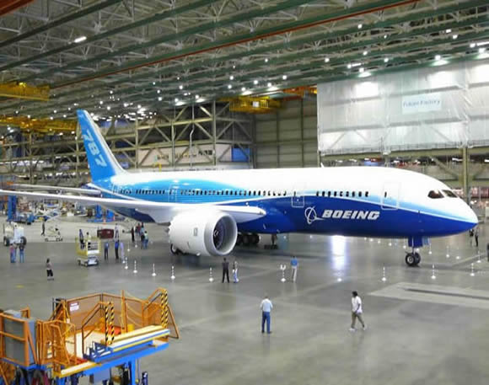
Introduction– Why “Taboo”?
Oxford English Dictionary:
taboo, tabu, a. and n.
c. Linguistics. A total or partial prohibition of the use of certain words, expressions, topics, etc., esp. in social intercourse.

Slide 4
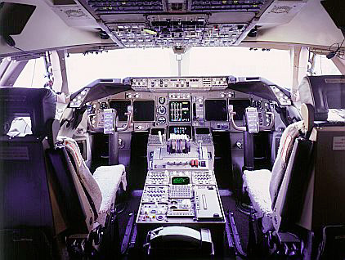
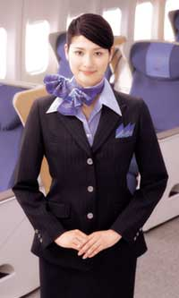
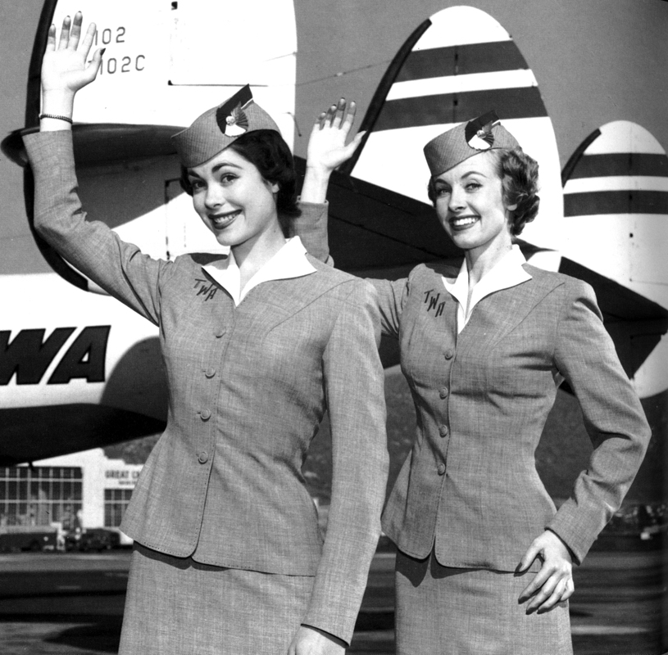
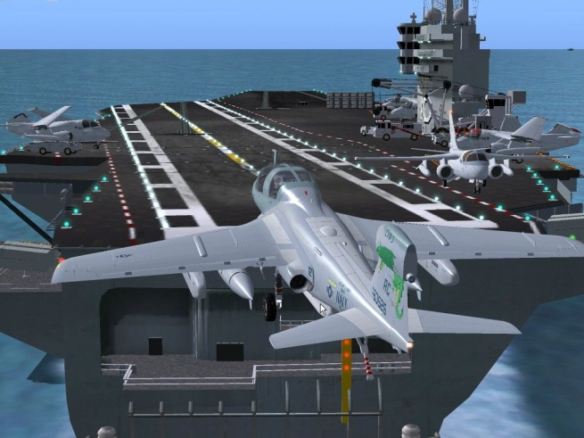
Old Terms vs. New Terms
Flight attendant vs. stewardess
Cockpit vs. flight deck
Rough air vs. turbulence

Slide 5
Determining old vs. New: OED
Stewardess– 1631, *1837
  Steward– ~1000 AD
Flight Attendant– 1947
Cockpit– 1706, *1914
Flight Deck– 1924, *1958
Turbulence– 1598, *1726, *1948
Rough Air– Unlisted in the OED

Slide 6
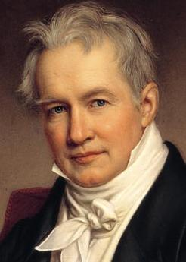
Relavence
Humboldt: “The differences between languages are not those of sounds and signs but those of differing world views.”

Slide 7
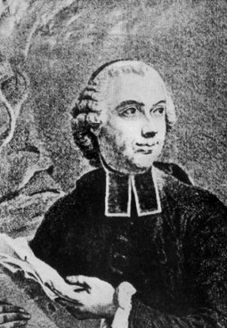
Relavence
Condillac: “Everything confirms that each language expresses the character of the people who speak it.”

Slide 8

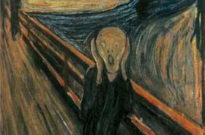
Relavence
Influence of feminism
Desire to be politically correct
Allay fear
  Chris Babb, Delta Air Lines
    “Turbulence is considered extremely unstable air. As a rule, turbulence is not encountered very often. Rough air is a nicer way of saying turbulence.”

Slide 9
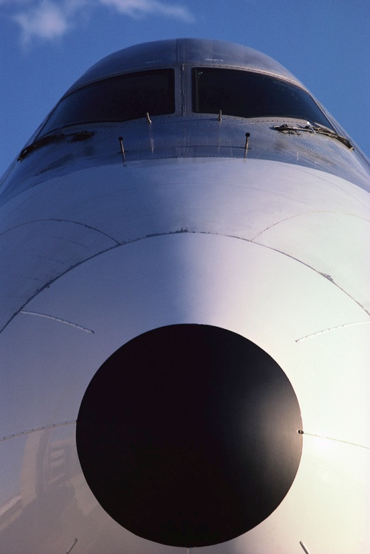
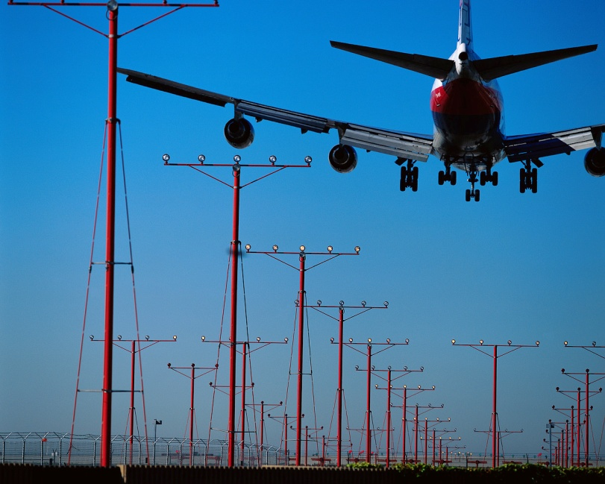
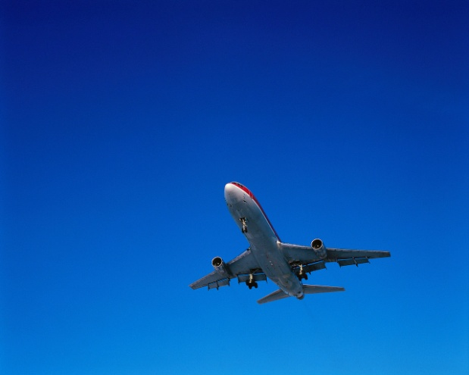
Two Sides
Old terms are still in greater use
  Stewardess
  Cockpit
  Turbulence
New terms are more prevalent
  Flight attendant
  Flight deck
  Rough air

Slide 10
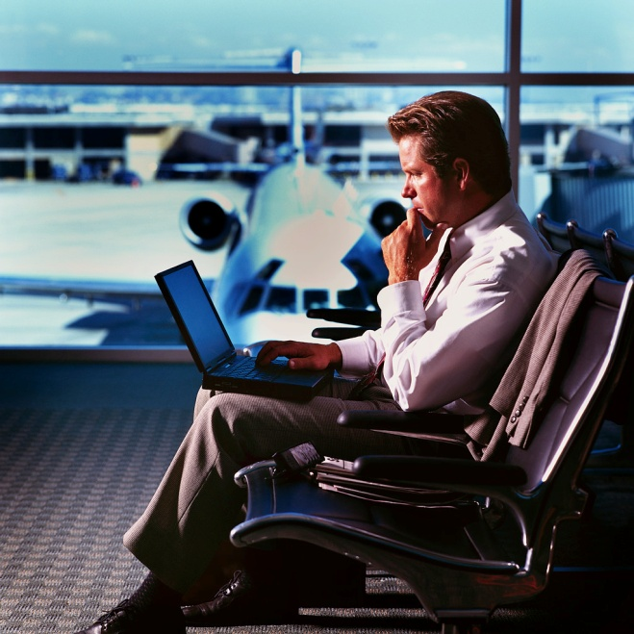
Methodology
30 Pilots
  15 male, 15 female
    After 2 hours, as many as possible
30 Flight Attendants
  15 male, 15 female
    After 2 hours, as many as possible
30 BYU Students
  15 male, 15 female
30 BYU Faculty/Staff
  15 male, 15 female

Slide 11
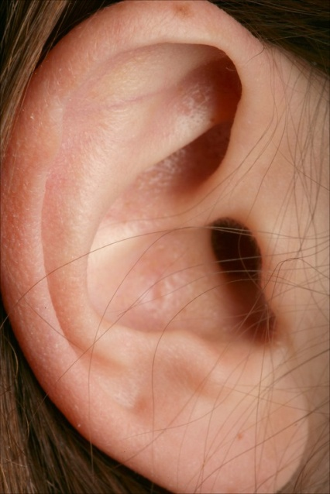
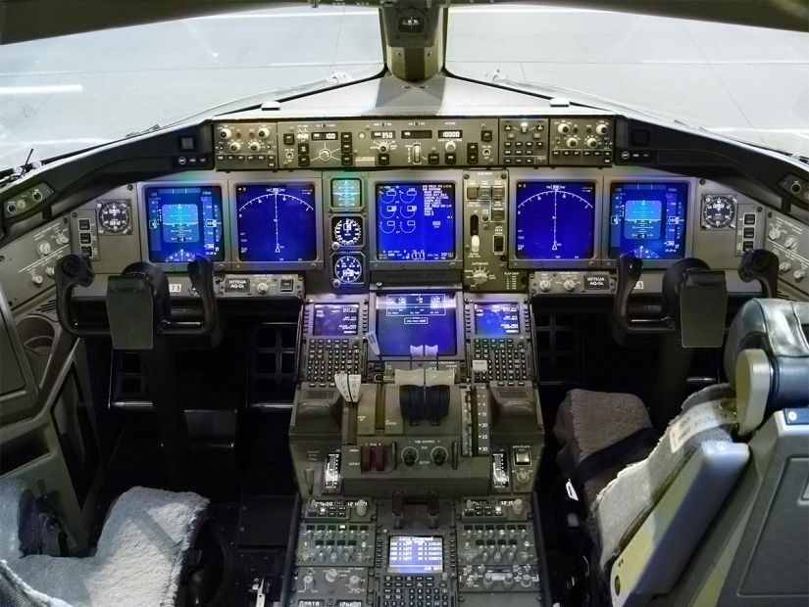
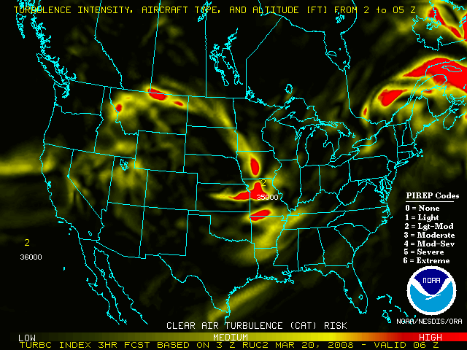

Methodology
What do you hear more often?
  Flight attendant or stewardess?
  Cockpit or flight deck?
  Rough air or turbulence?

Slide 12
Results– Stewardess vs. FA

Slide 13
Results– Cockpit vs. Flight DEck

Slide 14
Results– Rough Air vs. Turbulence

Slide 15
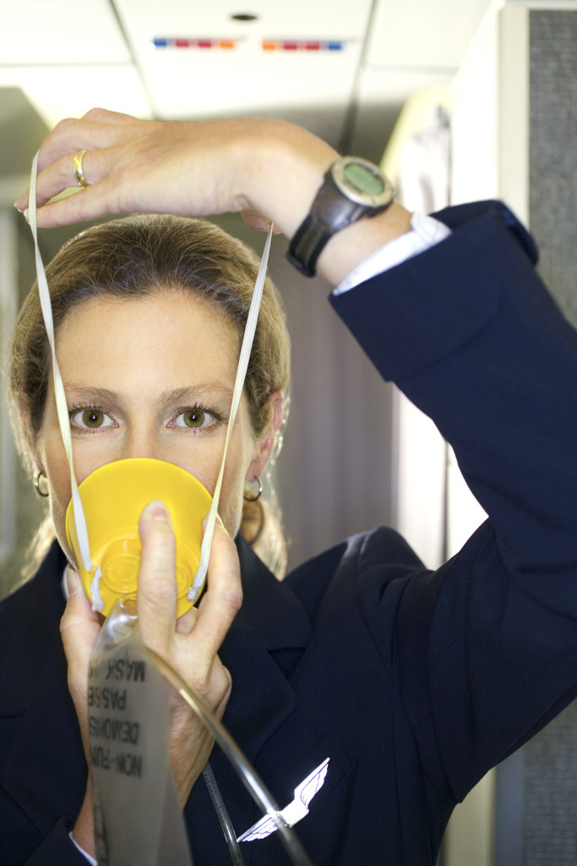
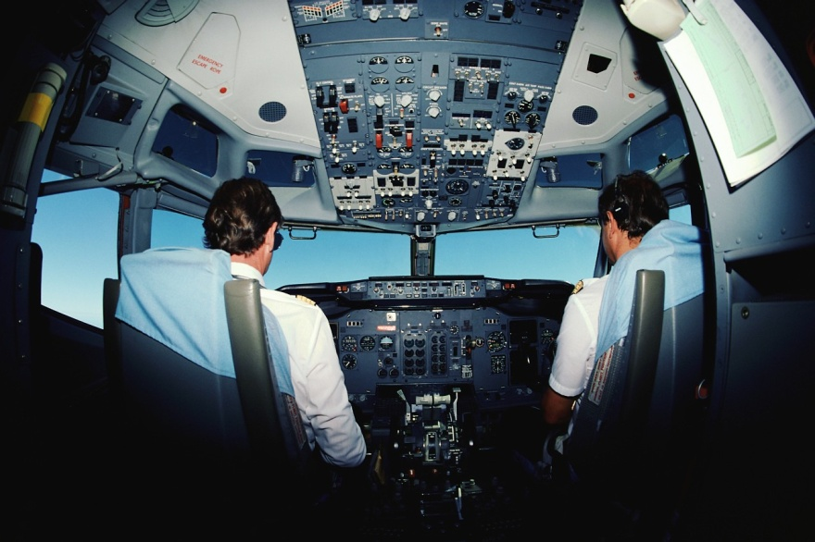
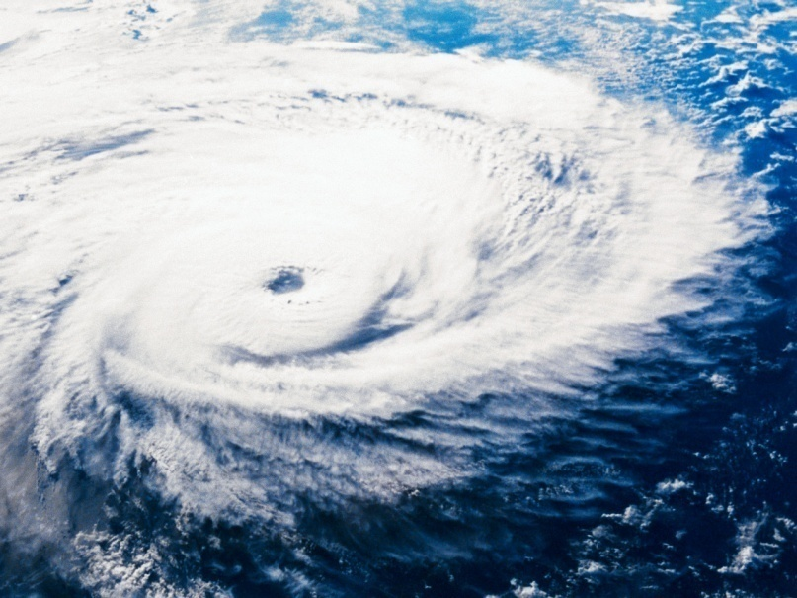
Winner?
Flight Attendant
Cockpit
Turbulence

Slide 16
Other OBservations
Airline crews (both pilots and FAs) were more likely to be evenly split between the old and new terms.
Female flight attendants listed that they heard the term stewardess more than the other groups (just over 50%).
This makes me wonder…

Slide 17
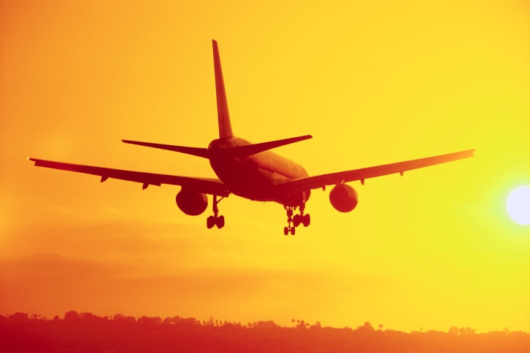
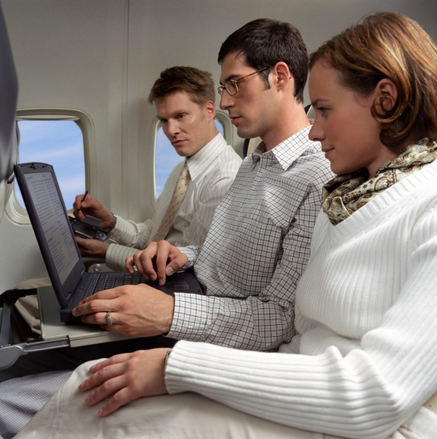
Future work
Variety of surveys
  What do you hear more often?
  What do you say more often?
  What do you think other people say more often?
Field linguistics
  Write what I hear when I fly.

